Slide 1
SHOBOT WEEKLY REPORT
J JAYAGOWTHAM
ME21B078

Slide 2
CREATION OF DATASET
Uploaded 3000+ images in the roboflow website
Along with my friend, who is also an intern in the Shobot project annotated over 500+ images manually.
Realized that it takes so much time so went ahead with some 400+ images for a rough model with 4 classes. (see Fig. 1)
Trained the model in the Roboflow website with an accuracy of 81.8 percent for 4 classes – Horlicks, Lays, Colgate, Hamam
Wrote a prediction script to predict random pictures clicked from arena (see fig. 3)
The training metrics are shown in Fig. 2 where we can observe that the loss is decreasing and accuracy is increasing.
The graph is abrupt because of the low number of input images.

Slide 3
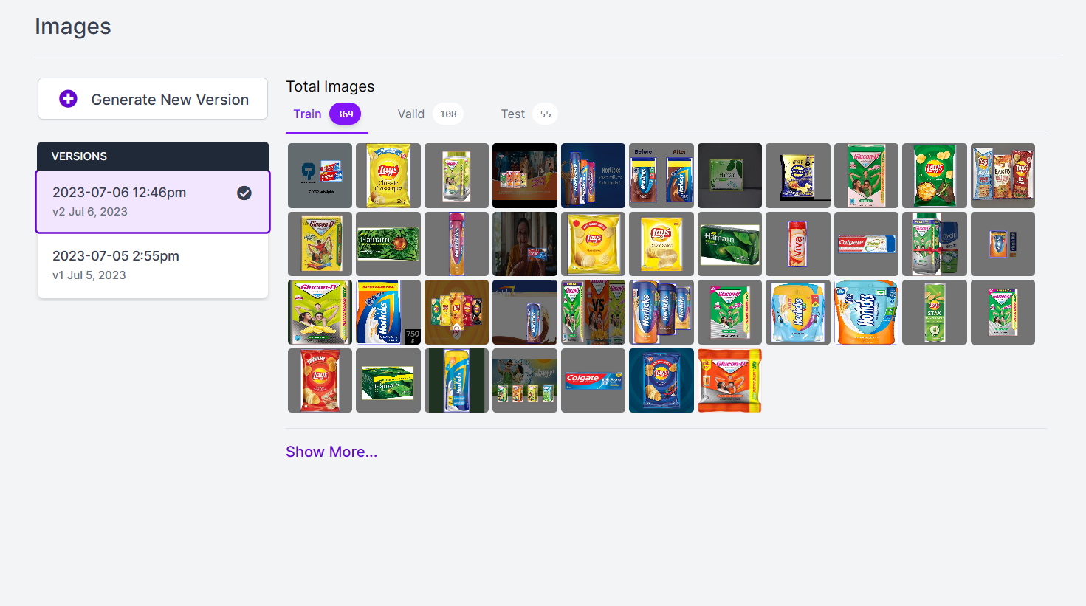
Fig.1 Dataset

Slide 4
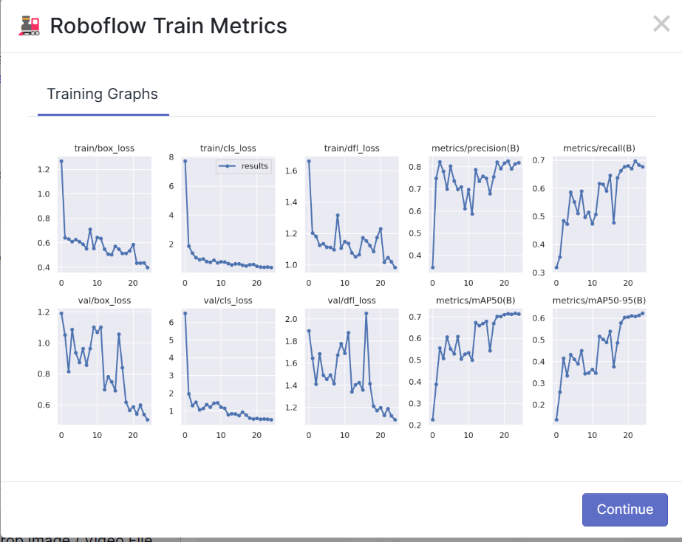
Fig.2 Roboflow website

Slide 5
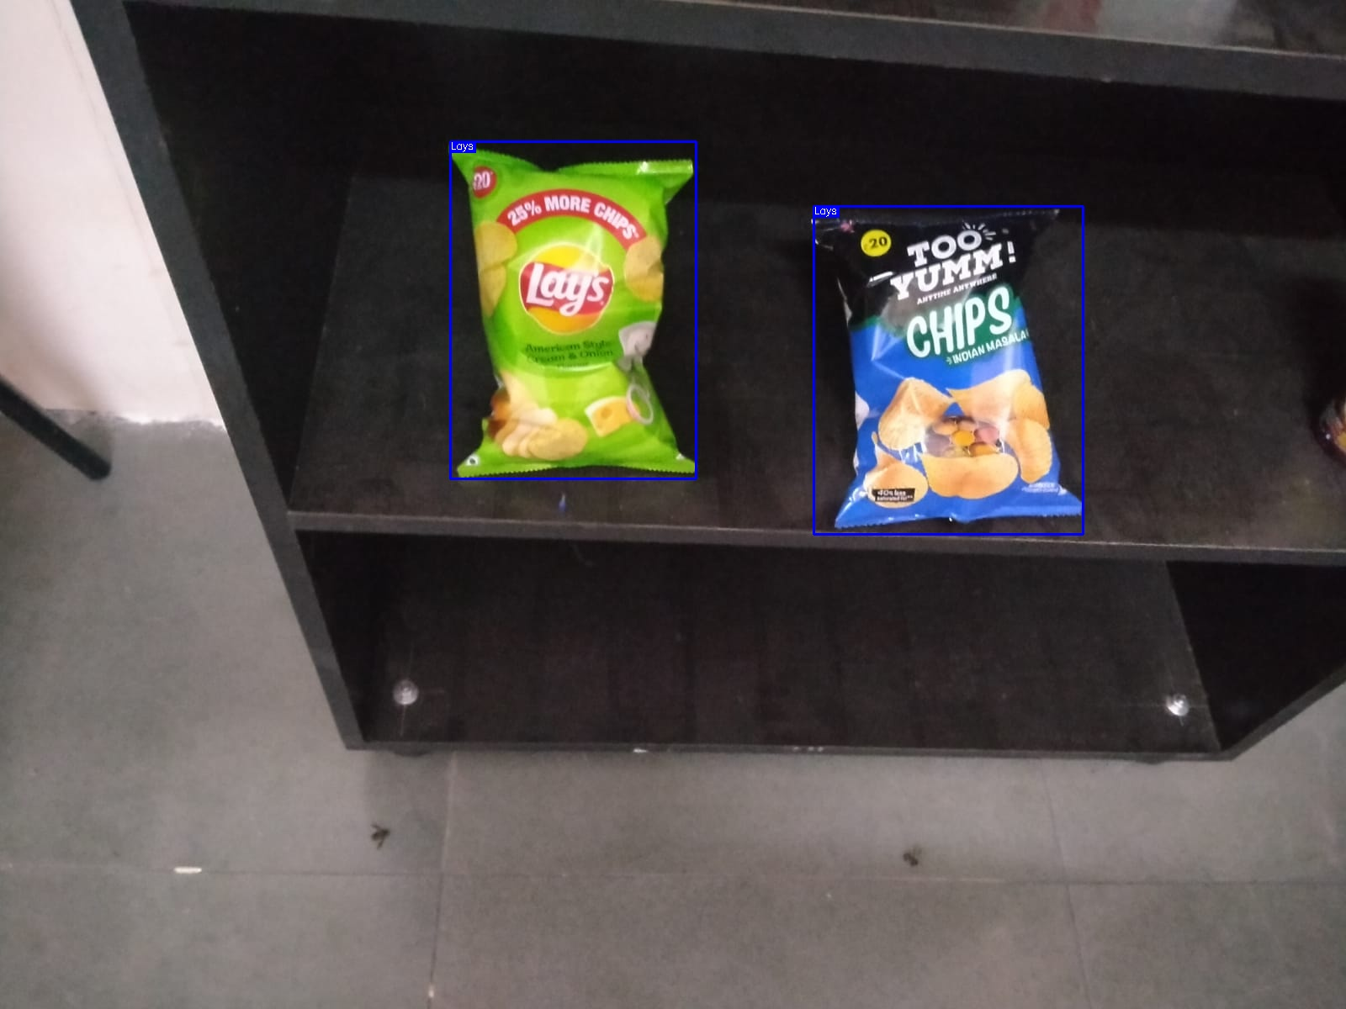
Fig.3 Sample Prediction

Slide 6
IMAGE DETECTION VIA SHOBOT
Learnt ROS for operation of Shobot
Wrote an ROS publisher for accessing the camera attached to the Shobot and getting the frames individually
The code also detects the objects in the frame, encloses them in a bounding box and provides us the final output. (See Fig. 4)

Slide 7
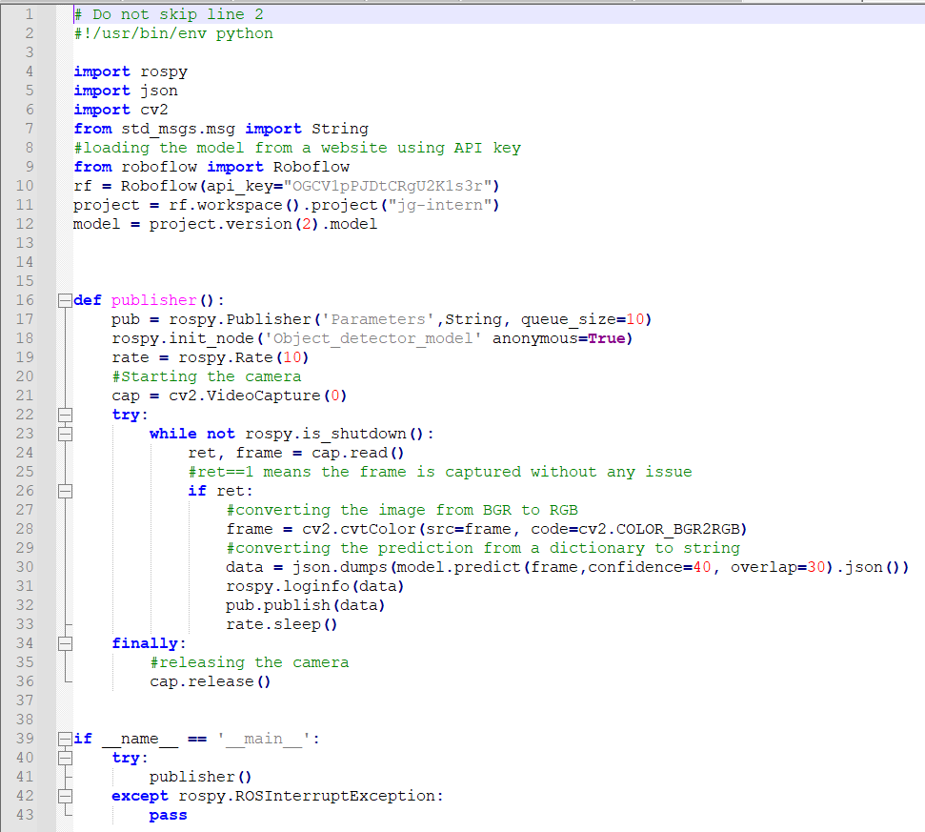
Fig.4 Publisher Code

Slide 8
NEXT WEEK PLAN
Test Shobot with the rough model
Return to the start of the loop and improve the ML model
Get more images and annotate them

